Slide 1
LECTURE 1
Developing LLM Applications
on Databricks
11 March 2026
16:00–18:00 CET
CAUCHY

Slide 2

Agenda
What we will cover today
CAUCHY
Development Options
Developing on Databricks: tools and serverless environments
Foundation Models
Overview of Databricks Foundation Models and hosting options
Project Overview
Project configuration, pyproject.toml structure
Provisioned Throughput
Deploy models with dedicated capacity
Example Code
Get info from arXiv and push metadata to Delta table
External Models
Deploy and manage external model endpoints
Databricks Asset Bundles
Run notebooks as jobs using Claude command

Slide 3
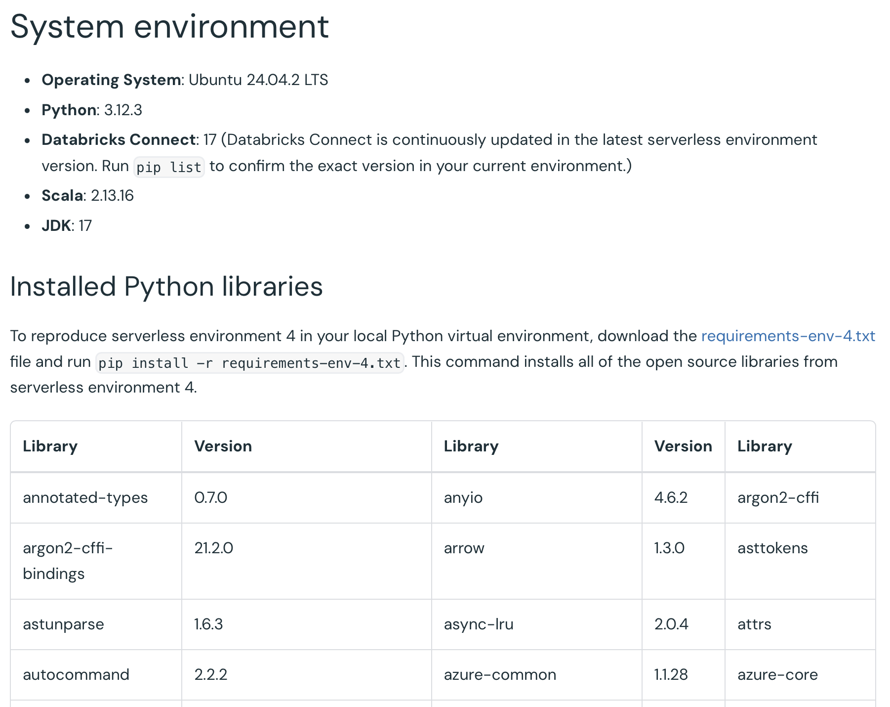
CAUCHY

Slide 4
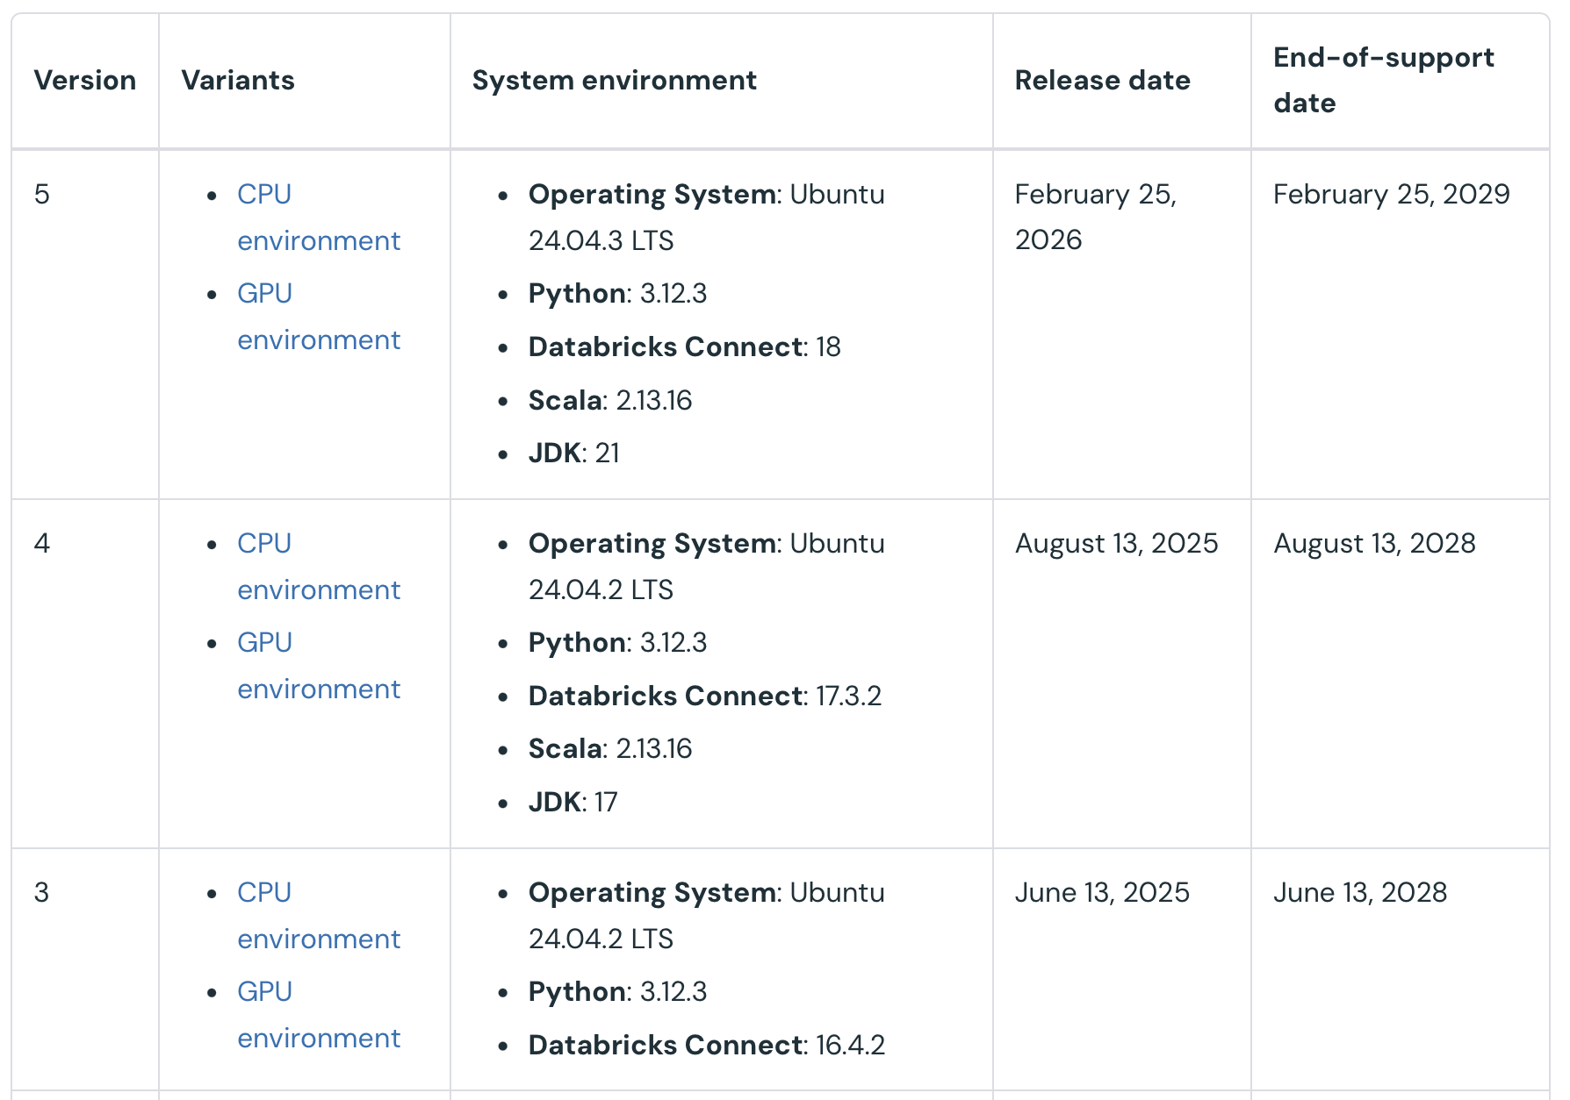
Serverless environment versions
CAUCHY
https://docs.databricks.com/aws/en/release-notes/serverless/environment-version/

Slide 5
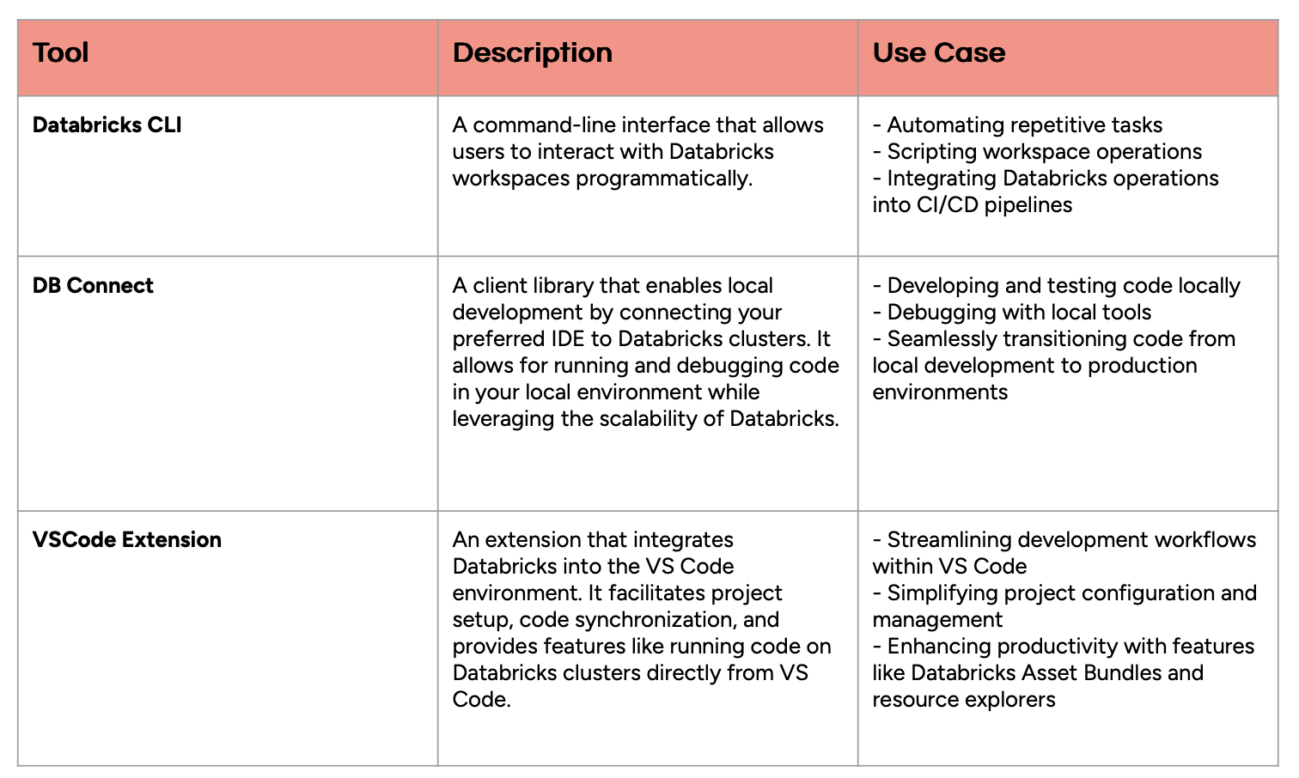
Databricks development tools
CAUCHY

Slide 6
Authentication using Databricks CLI
CAUCHY
1. Install the Databricks CLI if it’s not already installed.
$ brew tap databricks/tap
$ brew install databricks
2. Initiate Authentication: Run the command:
$ databricks auth login - configure-cluster - host <workspace-url>
3. Configuration Profiles: After entering your information, the CLI will prompt you to save it under a Databricks configuration profile.
4. Manage Profiles: To list or view settings of existing profiles, use:
$ databricks auth profiles
5. Web Browser Login
6. View Token Information: To view the current OAuth token and its expiration
databricks auth token --host https://dbc-90b329c4-aa90.cloud.databricks.com

Slide 7

Databricks asset bundles (DABs)
CAUCHY
DABs is a way to package and deploy Databricks resources and all their dependencies. It uses Terraform on the background
Other ways to deploy resources:
Terraform
Databricks APIs
Databricks asset bundles (DAB)
Databricks sdk
CLI
MLflow library

Slide 8
Resources supported through DABs
CAUCHY
Lakeflow jobs
Alerts
Apps
Clusters
Dashboards
Lakebase objects (database catalogs and instances, or synced database table)
SQL warehouses
Lakeflow Spark Declarative Pipelines
MLflow experiments – better via sdk/Mlflow library
Mosaic AI Model serving endpoints – better via sdk
Quality monitors – better via sdk
Unity-catalog objects (schemas, catalogs, volumes) – better through Terraform
Registered models – better via MLflow
Secret scopes – better through Terraform

Slide 9
Important DABs commands
CAUCHY
databricks bundle validate - validates all definitions
databricks bundle deploy - deploys the bundle
databricks bundle run <job name>- runs the job
databricks bundle destroy - destroys all resources specified in the bundle

Slide 10
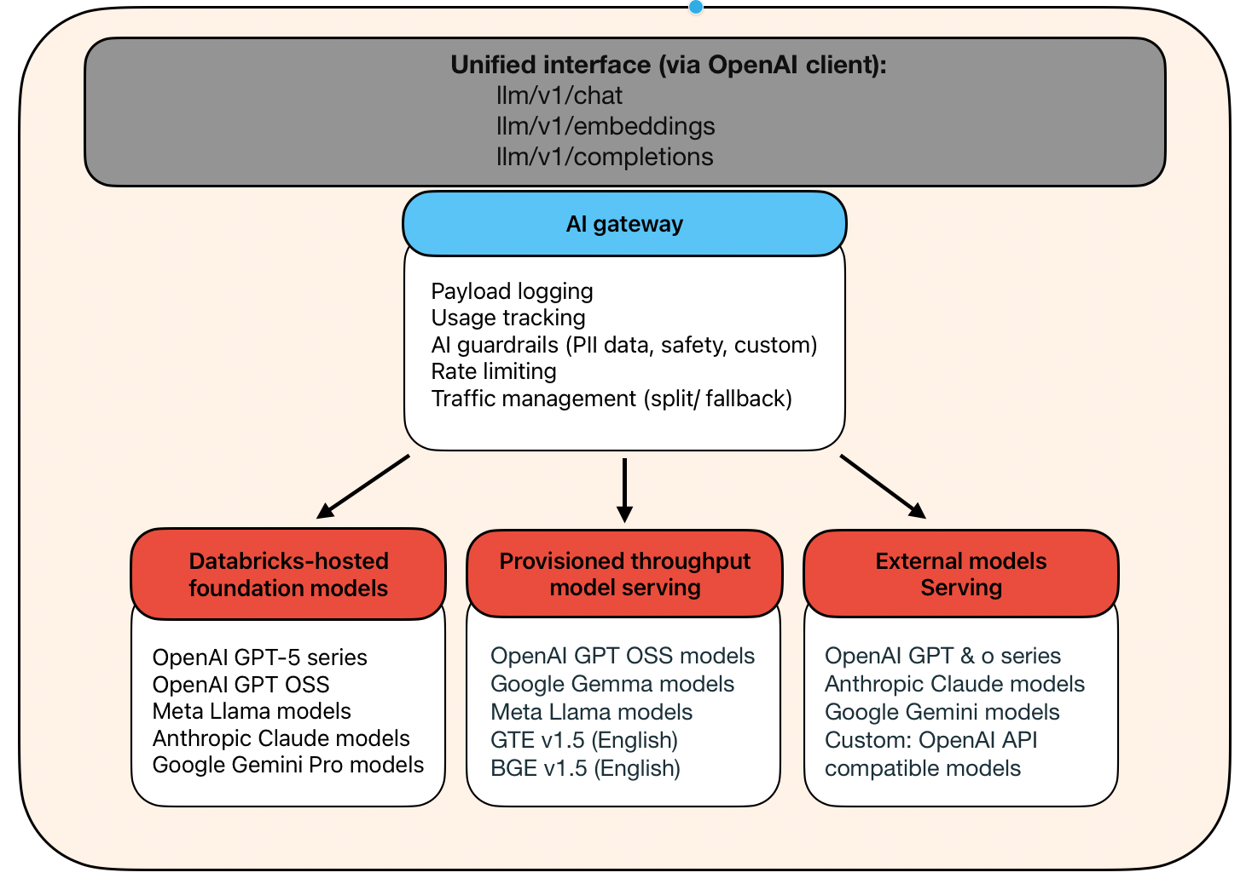
Databricks Foundation Models
The architecture of LLM systems on Databricks
CAUCHY
Notes:
this is the architecture of LLM systems on Databricks. At the foundation, we have three hosting options for models. All of these go through Mosaic AI Model Serving, which provides a unified interface, governance through AI Gateway, and safety through AI Guardrails. This architecture means you can switch between different models and providers without changing your application code - a huge advantage for experimentation and production flexibility.

Slide 11
Unified API
Mosaic AI Model Serving (OpenAI-compatible API)
CAUCHY
BENEFITS
SUPPORTED ENDPOINTS
Same code works across all hosting options
Easy to switch between models
Use OpenAI SDK directly
Simplified evaluation and fallback strategies
llm/v1/chat → Chat Completions
llm/v1/embeddings → Embeddings
llm/v1/completions → Legacy Completions
KEY INSIGHT
All models use the same OpenAI-compatible API interface
Switch between models just by changing the model name parameter.
Notes:
All models - whether hosted by Databricks, deployed with provisioned throughput, or external - follow the OpenAI API specification. This means you can use the OpenAI Python SDK to interact with any model. You can experiment with different models just by changing the model name parameter. This consistency is invaluable when you're evaluating models, implementing fallback strategies, or migrating from development to production​

Slide 12
AI Gateway Benefits
Governance capabilities between your application and models
CAUCHY
USAGE TRACKING
TRAFFIC MANAGEMENT
Monitor token consumption
Track costs per user/team
Rate limiting
Load balancing
Fallback strategies
PAYLOAD LOGGING
AI GUARDRAILS
Log all requests/responses
Debug and audit capabilities
Collect fine-tuning data
PII detection and masking
Content filtering
Input/output validation
Notes:
AI Gateway sits between your application and the models, providing critical governance capabilities. First, usage tracking lets you monitor token consumption and costs - essential for managing budgets. Second, payload logging, also called inference tables, captures every request and response, which is invaluable for debugging, auditing, and even collecting data for fine-tuning. Third, traffic management gives you rate limiting and load balancing. Finally, AI Guardrails ensure safety by detecting and masking PII, filtering harmful content, and validating inputs and outputs. All of this works automatically for any model served through Databricks.​

Slide 13
Databricks Hosted Models
Pay-per-token foundation model APIs
CAUCHY
BEST FOR
CHARACTERISTICS
RATE LIMITS
Experimentation and exploration
Development and testing
Low-volume production workloads
No infrastructure setup required
Pay only for tokens used
Subject to workspace rate limits
Availability varies by cloud provider/region
Input/output tokens per hour
Queries per hour
Most restrictive limit applies
429 error when limit reached
ZERO SETUP
Start making API calls immediately — no infrastructure provisioning required
Notes:
Databricks-hosted models are the easiest way to get started. They require zero infrastructure setup - you just start making API calls and pay for the tokens you use. They're perfect for experimentation, development, and even low-volume production use cases. However, they do have workspace-level rate limits on tokens per hour and queries per hour. If you hit these limits, you'll get a 429 error until the rate limit window resets. The available models depend on your cloud provider and region, so check the documentation for your specific environment.​

Slide 14
Provisioned Throughput
Production-ready model serving
CAUCHY
WHEN TO USE
KEY BENEFITS
High-volume production workloads
Latency-sensitive applications
Predictable, consistent performance
Fine-tuned model deployment
Dedicated capacity
Performance guarantees
Autoscaling support
Higher limits than hosted APIs
COST OPTIMIZATION
Scale-to-zero option available for cost savings
Not recommended for critical production systems, but great for development and staging environments.
Notes:
provisioned throughput, which is what you'll use for production workloads. Unlike pay-per-token models with shared capacity, provisioned throughput gives you dedicated infrastructure with performance guarantees. Use it when you have high-volume workloads, need consistent latency, or want to deploy your own fine-tuned models. The key advantages are dedicated capacity, much higher limits than hosted APIs, and intelligent autoscaling that adjusts to your demand. You can even enable scale-to-zero to save costs during idle periods, though we don't recommend this for critical production systems​

Slide 15
Measuring Capacity
How provisioned throughput capacity is measured
CAUCHY
TOKENS PER SECOND
EXAMPLE
MODEL UNITS
Combined input + output tokens
More reliable than requests/second
Varies by request size
Request: 2048 input + 256 output = 2304 tokens
2304 TPS = 1 request/second
4608 TPS = 2 requests/second
Used for some models (e.g., Llama 4 Maverick)
50 model units ≈ 3250 tokens/second
Simplifies capacity planning
WHY TPS?
LLM requests vary dramatically in size — TPS gives a consistent, predictable metric
Notes:
Provisioned throughput capacity is measured in tokens per second, not requests per second. Why? Because LLM requests vary dramatically in size. A short question might be 50 tokens, while a complex prompt with context could be 4000 tokens. Measuring in tokens per second gives you a consistent, predictable metric. For example, if your typical request is 2304 tokens total and you provision 2304 tokens per second, you can process one such request per second. Double the capacity, and you can process two per second. Some models use 'model units' as an abstraction ​

Slide 16
External Models
Hosted outside Databricks, accessed through Mosaic AI Model Serving
CAUCHY
SUPPORTED PROVIDERS
WHY USE VIA DATABRICKS
CONFIGURATION
Azure OpenAI
AWS Bedrock
Anthropic
Custom OpenAI-compatible APIs
Unified governance and monitoring
Consistent API interface
Usage tracking and cost management
AI Gateway benefits (guardrails, logging)
No code changes to switch providers
May require firewall rules (AWS)
Custom provider for advanced features
(e.g., image output via base64)
GOVERNANCE FIRST
Route through Databricks for unified governance — switch providers without changing code
Notes:
​
External models are hosted outside Databricks but can be accessed through Mosaic AI Model Serving. You might wonder why you'd route through Databricks instead of calling these providers directly. The answer is governance and consistency. By creating a serving endpoint that proxies to an external model, you get all the benefits of AI Gateway - usage tracking, payload logging, guardrails, and a unified interface. You can switch from OpenAI to Anthropic just by changing the endpoint configuration, without touching your application code. Some providers may require firewall configuration, particularly on AWS. The custom provider option is particularly useful for accessing advanced features that aren't yet supported by the out-of-the-box integrations, like OpenAI's image output capabilities​

Slide 17
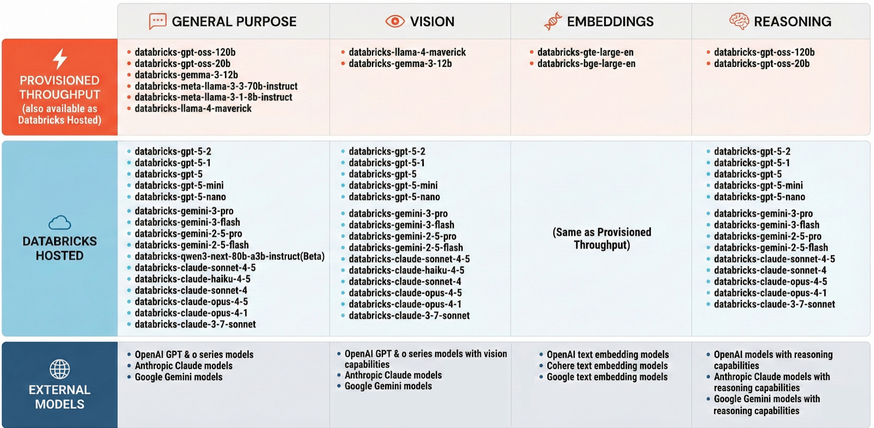
Databricks Foundation Models
Comparison of the three hosting options
CAUCHY
Notes:
Databricks offers three ways to work with foundation models. First, Databricks-hosted models are perfect for getting started - they're available immediately with no configuration, but they have workspace-level rate limits. Second, provisioned throughput is what you'll use in production - it gives you dedicated capacity with performance guarantees and autoscaling. Third, external models let you connect to providers like OpenAI or Anthropic while still getting the benefits of Databricks governance. The key insight here is that all three options use the same API interface, so you can start with hosted models and move to provisioned throughput without changing your code.​

Slide 18
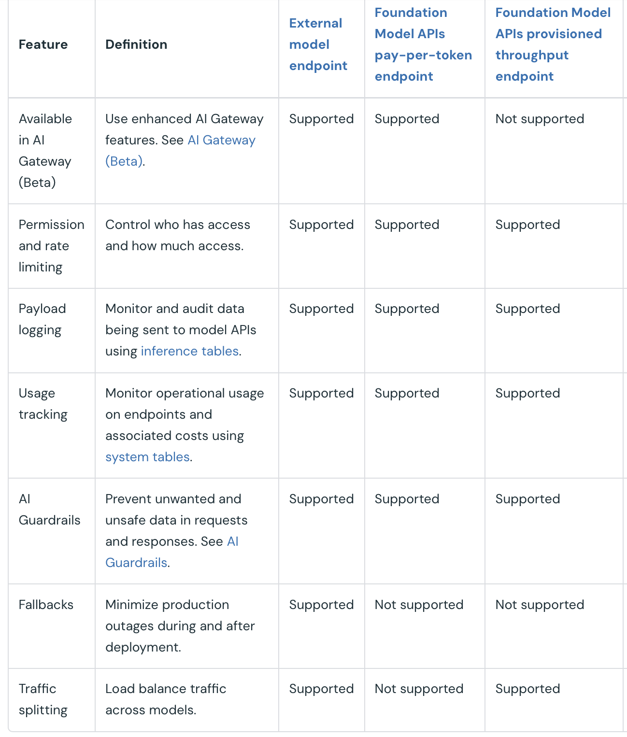
What is supported for AI gateway
CAUCHY
https://docs.databricks.com/aws/en/ai-gateway/overview-serving-endpoints

Slide 19
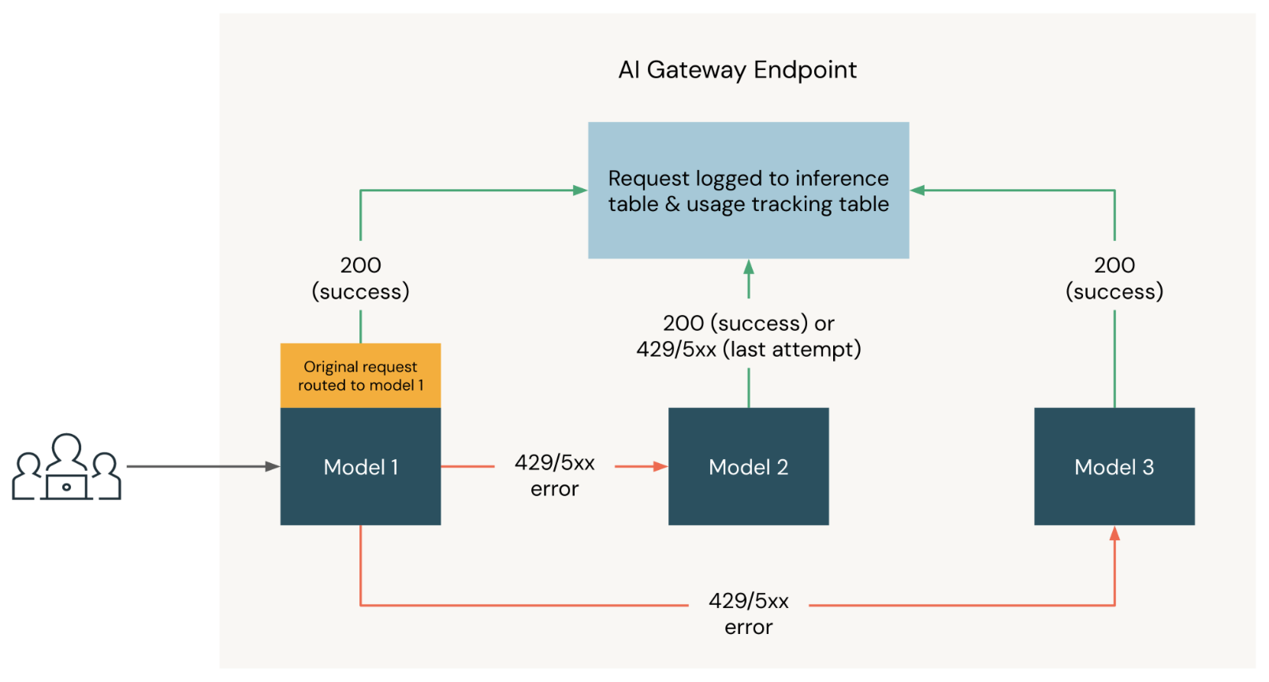
AI gateway: fallbacks
CAUCHY

Slide 20
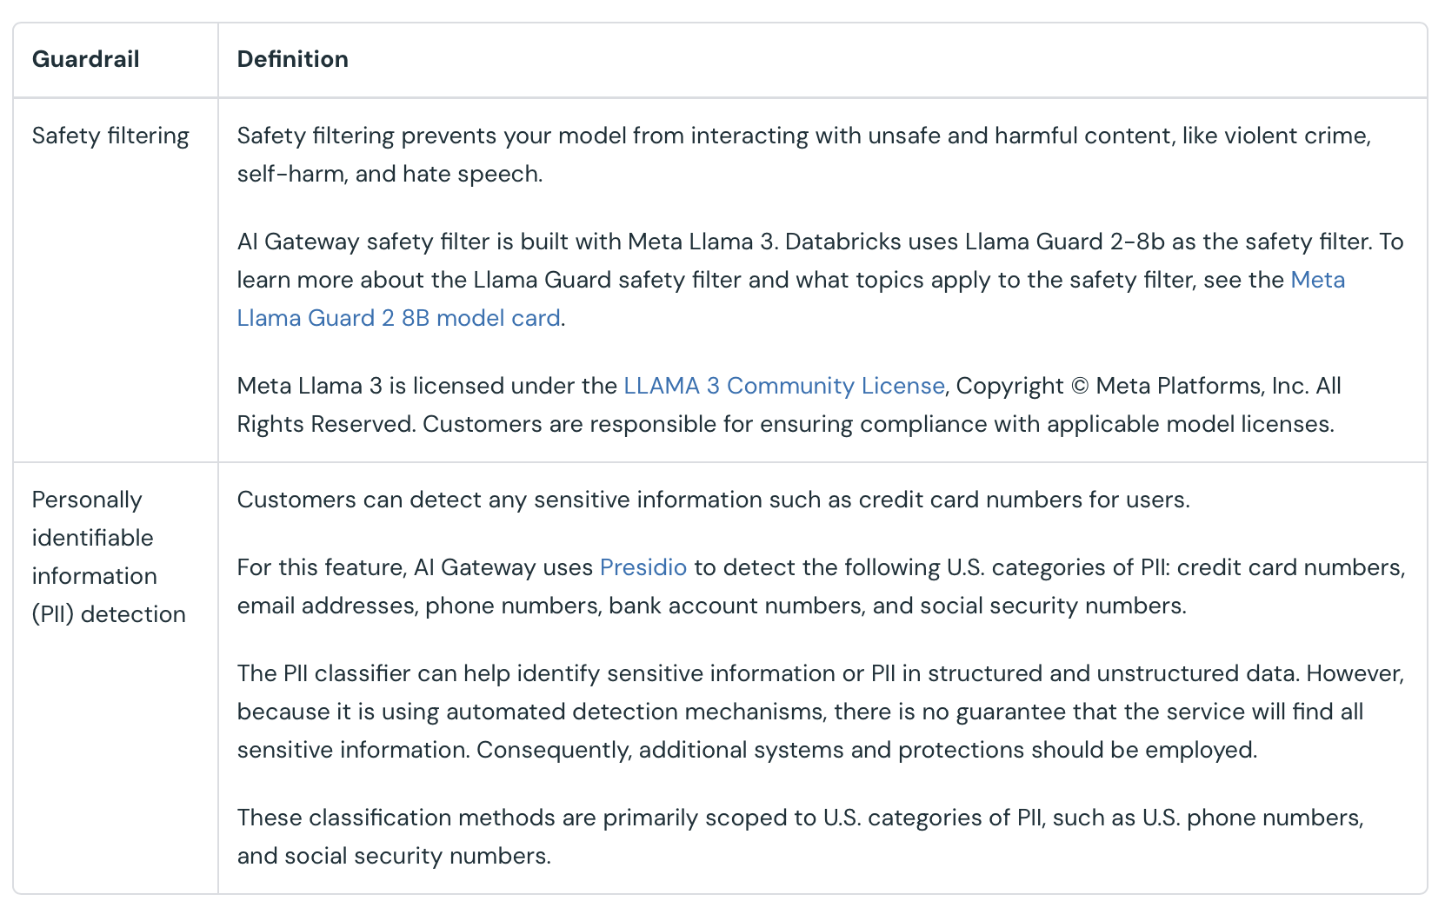
AI gateway: guardrails
CAUCHY
https://docs.databricks.com/aws/en/ai-gateway/overview-serving-endpoints#define-guardrails

Slide 21
Homework
CAUCHY
Choose your own use case to work on
Preprocess data for your use case in VS code, run data processing notebook on Databricks
Experiment with LLM calling
Submit PR

Slide 22
CAUCHY
Questions?

